Slide 1
Modeling and Simulation of Magnetic Transmission Lines
Muhammad Shamaas
2018-MS-EE-4

Slide 2
Introduction to Magnetic Transmission Lines
Intrinsically, Magnetic Transmission Line is made from a magnetic material, with a very high relative permeability.
Magnetomotive Force produces a displacement current in the transmission line.
The operation of a Magnetic Transmission Line does not involve electric charges. However, changing Magnetic Fields produce Electric Fields which is stored in the Electric Field of the dielectric medium.
These relations must be modeled using Maxwell’s Equations and magnetic circuits to study the time and frequency domain behavior of Magnetic Transmission Lines.

Slide 3
Classification of Magnetic Materials

Slide 4

Losses in Magnetic Materials
Dielectric Loss Tangent are defined as
$$tanδ_{m}=\frac{μ^{′′}}{μ^{′}}$$

Slide 5
Applications of Magnetic Transmission Lines
Inductors and Magnetic Amplifiers.
Transformers: Power Transformers, Ferro-resonant Constant Voltage Transformers, Wideband Transformers, Pulse Transformers.
Alternating Current and Direct Current Machines.
Computers and High Frequency Electronics.
Noise and skin effect suppression using magnetic thin films, ferrite beads and ribbons.
Directional Couplers and Magnetometers.
Induction Heaters and Magneto-resistive Sensors.
Gyromagnetic Devices: Microwave generators and Magnetic Resonance Imaging.

Slide 6
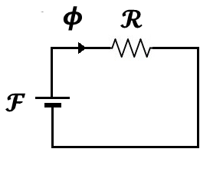
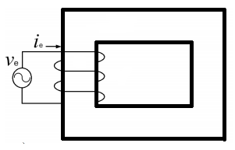
Lossy Complex Magnetic Reluctance Model for Iron Core Coil

Slide 7
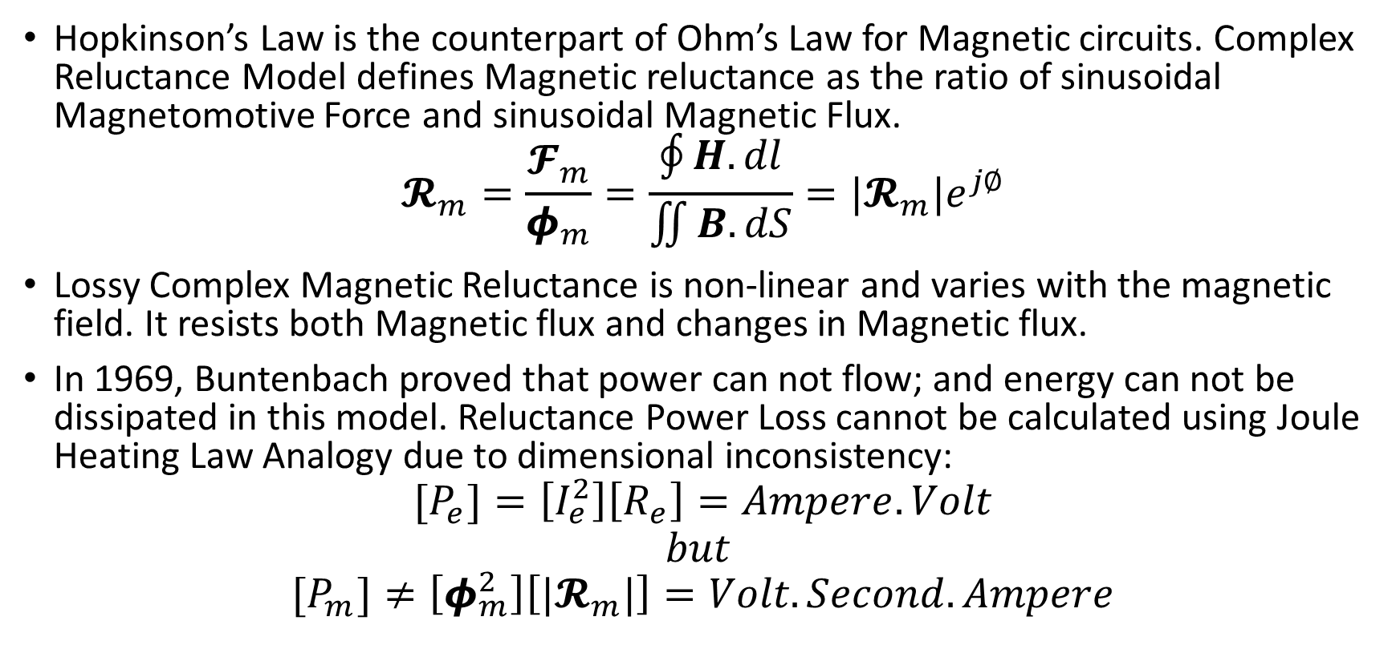
Lossy Complex Magnetic Reluctance Model for Magnetic Circuits
Hopkinson’s Law is the counterpart of Ohm’s Law for Magnetic circuits. Complex Reluctance Model defines Magnetic reluctance as the ratio of sinusoidal Magnetomotive Force and sinusoidal Magnetic Flux.
$$𝓡_{m}=\frac{𝓕_{m}}{φ_{m}}=\frac{\oint{H.dl}}{\iint{B.dS}}=|𝓡_{m}|e^{j∅}$$
Lossy Complex Magnetic Reluctance is non-linear and varies with the magnetic field. It resists both Magnetic flux and changes in Magnetic flux.
In 1969, Buntenbach proved that power can not flow; and energy can not be dissipated in this model. Reluctance Power Loss cannot be calculated using Joule Heating Law Analogy due to dimensional inconsistency:
$$[P_{e}]=\left[I_{e}^{2}\right]\left[R_{e}\right]=Ampere.Volt$$
$$but$$
$${[P}_{m}]≠\left[φ_{m}^{2}\right]\left[|𝓡_{m}|\right]=Volt.Second.Ampere$$

Slide 8
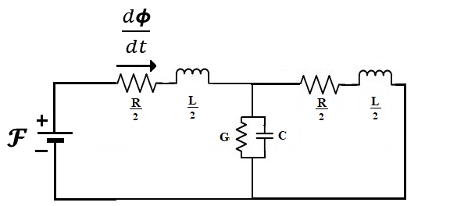
Power Invariant Permeance-Capacitor Model for Iron Core Coil

Slide 9
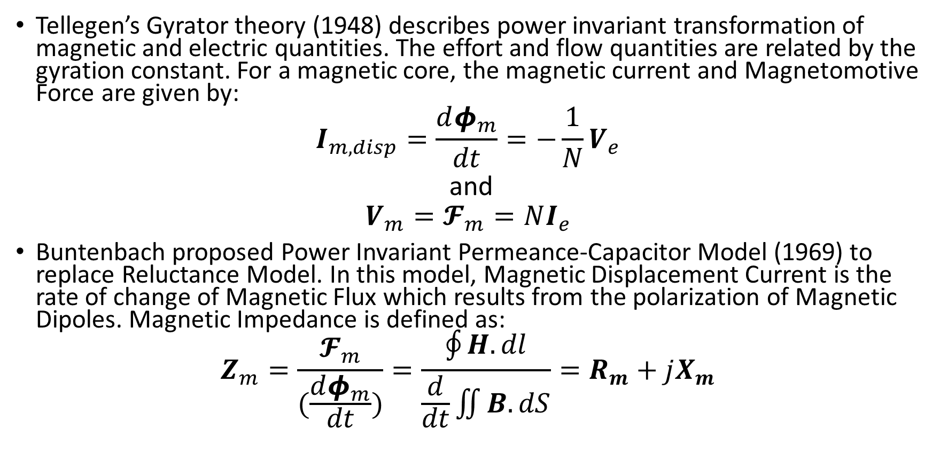
Power Invariant Permeance-Capacitor Model for Magnetic Circuits
Tellegen’s Gyrator theory (1948) describes power invariant transformation of magnetic and electric quantities. The effort and flow quantities are related by the gyration constant. For a magnetic core, the magnetic current and Magnetomotive Force are given by:
$$I_{m,disp}=\frac{dφ_{m}}{dt}=−\frac{1}{N}V_{e}$$
and
$$V_{m}=𝓕_{m}=NI_{e}$$
Buntenbach proposed Power Invariant Permeance-Capacitor Model (1969) to replace Reluctance Model. In this model, Magnetic Displacement Current is the rate of change of Magnetic Flux which results from the polarization of Magnetic Dipoles. Magnetic Impedance is defined as:
$$Z_{m}=\frac{𝓕_{m}}{(\frac{dφ_{m}}{dt})}=\frac{\oint{H.dl}}{\frac{d}{dt}\iint{B.dS}}=R_{m}+jX_{m}$$

Slide 10
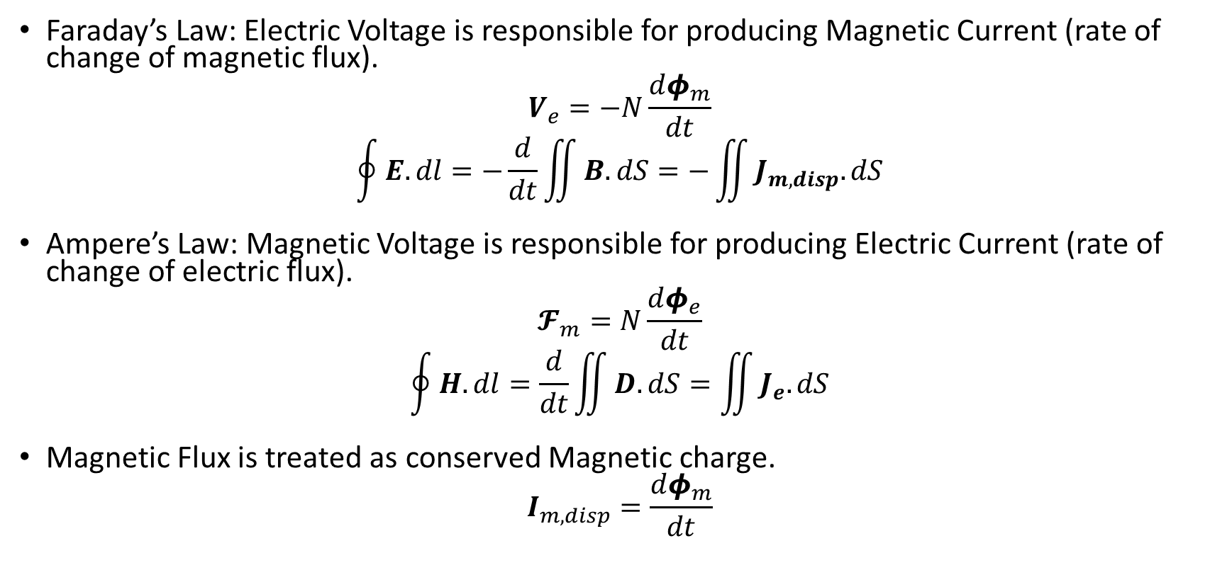
Implications of Permeance-Capacitor Model
Faraday’s Law: Electric Voltage is responsible for producing Magnetic Current (rate of change of magnetic flux).
$$V_{e}=−N\frac{dφ_{m}}{dt}$$
$$\oint{E.dl}=−\frac{d}{dt}\iint{B.dS}=−\iint{J_{m,disp}.dS}$$
Ampere’s Law: Magnetic Voltage is responsible for producing Electric Current (rate of change of electric flux).
$$𝓕_{m}=N\frac{dφ_{e}}{dt}$$
$$\oint{H.dl}=\frac{d}{dt}\iint{D.dS}=\iint{J_{e}.dS}$$
Magnetic Flux is treated as conserved Magnetic charge.
$$I_{m,disp}=\frac{dφ_{m}}{dt}$$

Slide 11
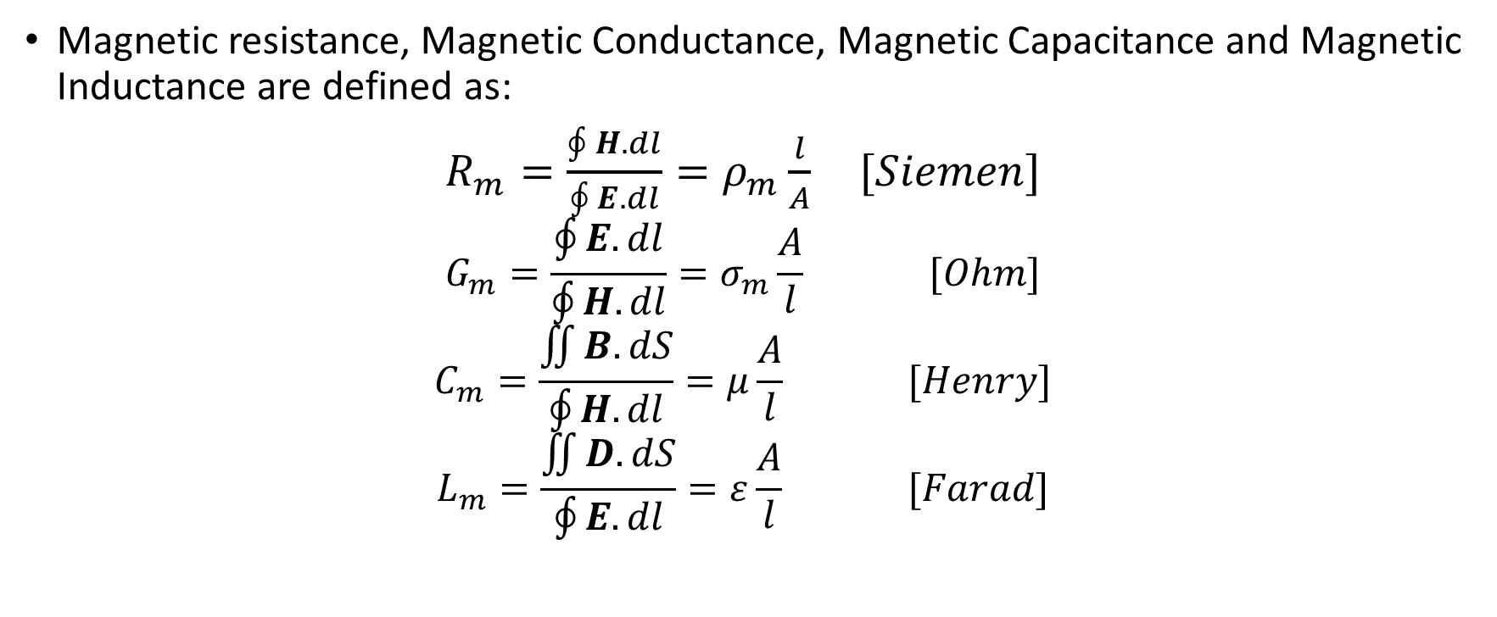
Components in Permeance-Capacitor Model
Magnetic resistance, Magnetic Conductance, Magnetic Capacitance and Magnetic Inductance are defined as:
$R_{m}=\frac{\oint{H.dl}}{\oint{E.dl}}=ρ_{m}\frac{l}{A} [Siemen]$
$$G_{m}=\frac{\oint{E.dl}}{\oint{H.dl}}=σ_{m}\frac{A}{l} [Ohm]$$
$$C_{m}=\frac{\iint{B.dS}}{\oint{H.dl}}=μ\frac{A}{l} [Henry]$$
$$L_{m}=\frac{\iint{D.dS}}{\oint{E.dl}}=ε\frac{A}{l} [Farad]$$
R=effort variable/flow variable. G=flow variable/effort variable. C=charge variable/effort variable. L=dual charge variable/flow variable.

Slide 12
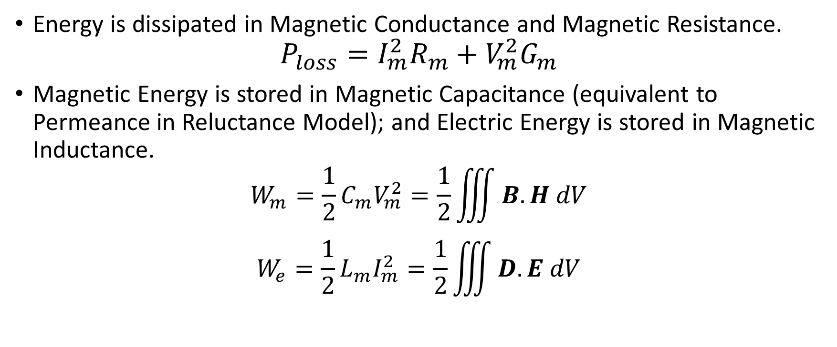
Energy Loss and Energy Storage in Permeance-Capacitor Model
Energy is dissipated in Magnetic Conductance and Magnetic Resistance.
$$P_{loss}=I_{m}^{2}R_{m}+V_{m}^{2}G_{m}$$
Magnetic Energy is stored in Magnetic Capacitance (equivalent to Permeance in Reluctance Model); and Electric Energy is stored in Magnetic Inductance.
$$W_{m}=\frac{1}{2}{C_{m}V}_{m}^{2}=\frac{1}{2}\iiint{B.H dV}$$
$$W_{e}=\frac{1}{2}{L_{m}I}_{m}^{2}=\frac{1}{2}\iiint{D.E dV}$$

Slide 13
Comparison of Complex Reluctance Model and Power Invariant Model
 | Reluctance Model | Permeance-Capacitor Model
Conserved Quantity | ? | Magnetic Flux [Volt-Second]
Flow Variable | Magnetic Flux [Volt-Second] | Rate of change of Magnetic Flux [Volt]
Effort Variable | Magnetomotive Force [Ampere] | Magnetomotive Force [Ampere]
Energy Dissipative Element | ? | Magnetic Resistance [Siemen] and Magnetic Conductance [Ohm]
Electrical Energy Storage Element | ? | Magnetic Inductance [Farad]
Magnetic Energy Storage Element | ? | Magnetic Capacitance [Henry]

Slide 14
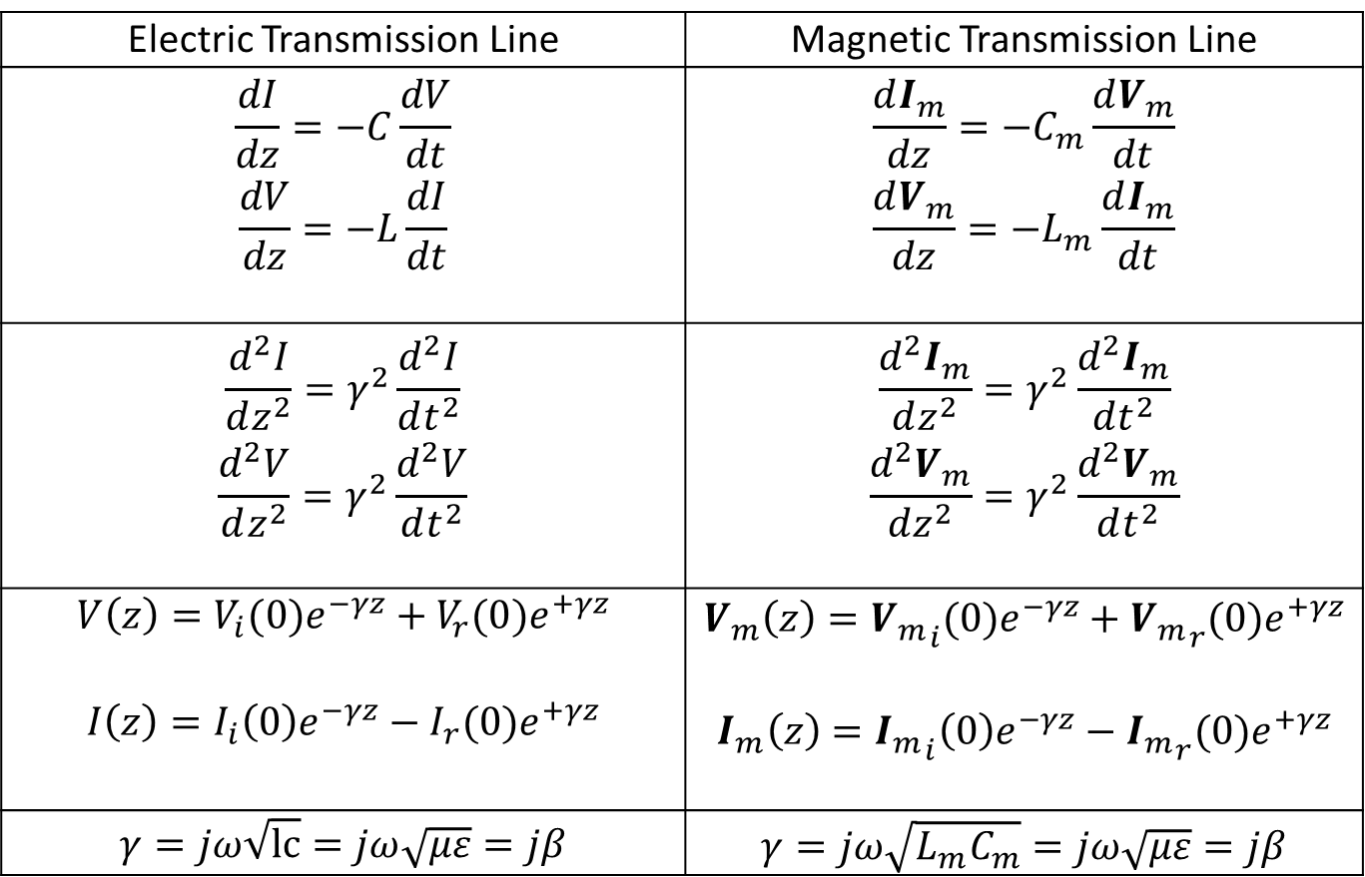
Lossless Magnetic Transmission Line
Electric Transmission Line | Magnetic Transmission Line
$$\frac{dI}{dz}=−C\frac{dV}{dt}$$ $$\frac{dV}{dz}=−L\frac{dI}{dt}$$ | $$\frac{dI_{m}}{dz}=−C_{m}\frac{dV_{m}}{dt}$$ $$\frac{dV_{m}}{dz}=−L_{m}\frac{dI_{m}}{dt}$$
$$\frac{d^{2}I}{dz^{2}}=γ^{2}\frac{d^{2}I}{dt^{2}}$$ $$\frac{d^{2}V}{dz^{2}}=γ^{2}\frac{d^{2}V}{dt^{2}}$$ | $$\frac{d^{2}I_{m}}{dz^{2}}=γ^{2}\frac{d^{2}I_{m}}{dt^{2}}$$ $$\frac{d^{2}V_{m}}{dz^{2}}=γ^{2}\frac{d^{2}V_{m}}{dt^{2}}$$
$$V\left(z\right)=V_{i}(0)e^{−γz}+V_{r}(0)e^{+γz}$$ $$I\left(z\right)=I_{i}\left(0\right)e^{−γz}−I_{r}(0)e^{+γz}$$ | $$V_{m}\left(z\right)={V_{m}}_{i}(0)e^{−γz}+{V_{m}}_{r}(0)e^{+γz}$$ $$I_{m}\left(z\right)={I_{m}}_{i}\left(0\right)e^{−γz}−{I_{m}}_{r}(0)e^{+γz}$$
$$γ=jω\sqrt{lc}=jω\sqrt{με}=jβ$$ | $$γ=jω\sqrt{L_{m}C_{m}}=jω\sqrt{με}=jβ$$

Slide 15
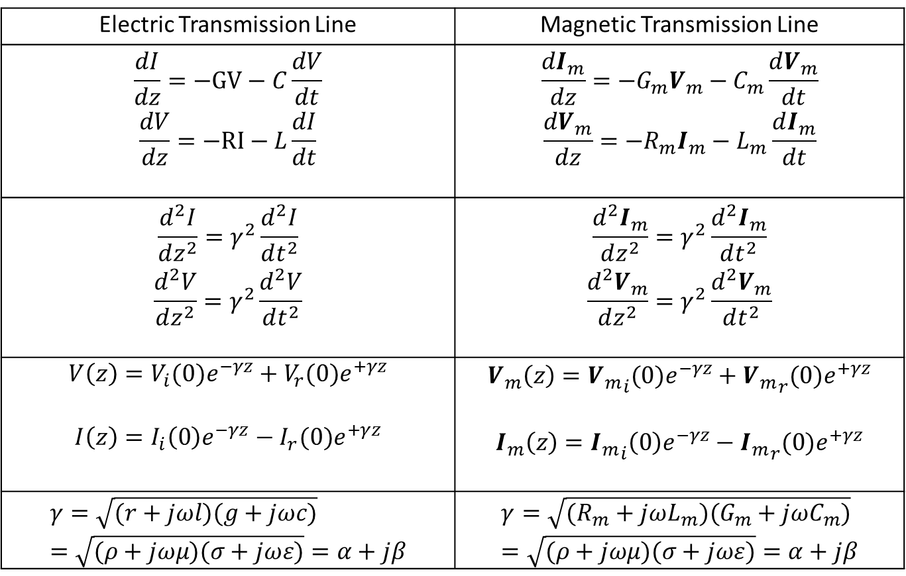
Lossy Magnetic Transmission Line
Electric Transmission Line | Magnetic Transmission Line
$$\frac{dI}{dz}=−GV−C\frac{dV}{dt}$$ $$\frac{dV}{dz}=−RI−L\frac{dI}{dt}$$ | $$\frac{dI_{m}}{dz}=−G_{m}V_{m}−C_{m}\frac{dV_{m}}{dt}$$ $$\frac{dV_{m}}{dz}=−R_{m}I_{m}−L_{m}\frac{dI_{m}}{dt}$$
$$\frac{d^{2}I}{dz^{2}}=γ^{2}\frac{d^{2}I}{dt^{2}}$$ $$\frac{d^{2}V}{dz^{2}}=γ^{2}\frac{d^{2}V}{dt^{2}}$$ | $$\frac{d^{2}I_{m}}{dz^{2}}=γ^{2}\frac{d^{2}I_{m}}{dt^{2}}$$ $$\frac{d^{2}V_{m}}{dz^{2}}=γ^{2}\frac{d^{2}V_{m}}{dt^{2}}$$
$$V\left(z\right)=V_{i}(0)e^{−γz}+V_{r}(0)e^{+γz}$$ $$I\left(z\right)=I_{i}\left(0\right)e^{−γz}−I_{r}(0)e^{+γz}$$ | $$V_{m}\left(z\right)={V_{m}}_{i}(0)e^{−γz}+{V_{m}}_{r}(0)e^{+γz}$$ $$I_{m}\left(z\right)={I_{m}}_{i}\left(0\right)e^{−γz}−{I_{m}}_{r}(0)e^{+γz}$$
$$γ=\sqrt{(r+jωl)(g+jωc)}=\sqrt{(ρ+jωμ)(σ+jωε)}=α+jβ$$ | $$γ=\sqrt{(R_{m}+jωL_{m})(G_{m}+jωC_{m})}=\sqrt{(ρ+jωμ)(σ+jωε)}=α+jβ$$

Slide 16
Introduction to MEEP
MEEP is a script based Finite Difference Time Domain Electromagnetic Fields Simulator for solving Maxwell’s Equations.
MEEP is ideal for modeling the time domain and frequency domain behavior of a variety of arbitrary materials including anisotropic, dispersive, non-linear dielectrics, electric/ magnetic conductors, media with saturable gain/ absorption, and gyrotropic media.
The C++ interface has the features of variable resolution and normalized units.
Sample data for several materials is provided in libraries for building accurate test structures.
A wide variety of electric or magnetic current sources can be simulated.
Many derived components can be evaluated like Curl, Divergence, Energy Density, Potential, Flux, Poynting vector etc.
Several Mathematical operations like averaging, symmetry and integration over a line, surface or volume are allowed in cylindrical and rectangular coordinates.
The fields can be printed as image or video files as well.
A frequency domain solver is also provided for multidimensional Laplace transformation and the decomposition of fields into travelling modes.

Slide 17
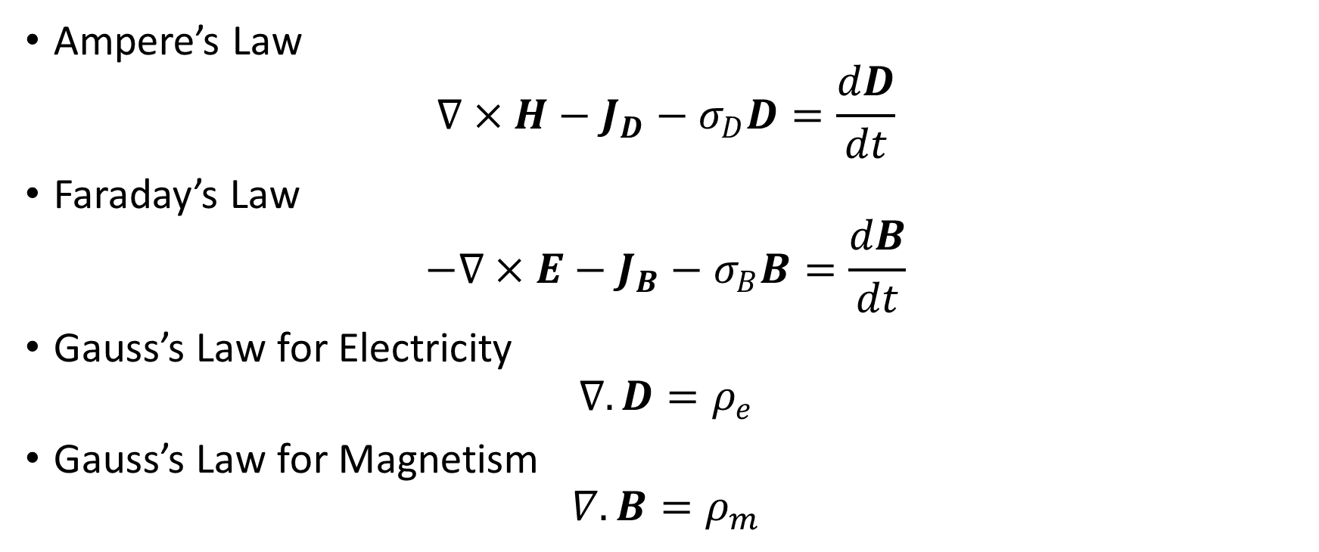
MEEP: Fully Symmetric Maxwell’s Equations with Fictitious Magnetic Monopoles
Ampere’s Law
$$∇×H−J_{D}−σ_{D}D=\frac{dD}{dt}$$
Faraday’s Law
$$−∇×E−J_{B}−σ_{B}B=\frac{dB}{dt}$$
Gauss’s Law for Electricity
$$∇.D=ρ_{e}$$
Gauss’s Law for Magnetism
$$∇.B=ρ_{m}$$

Slide 18
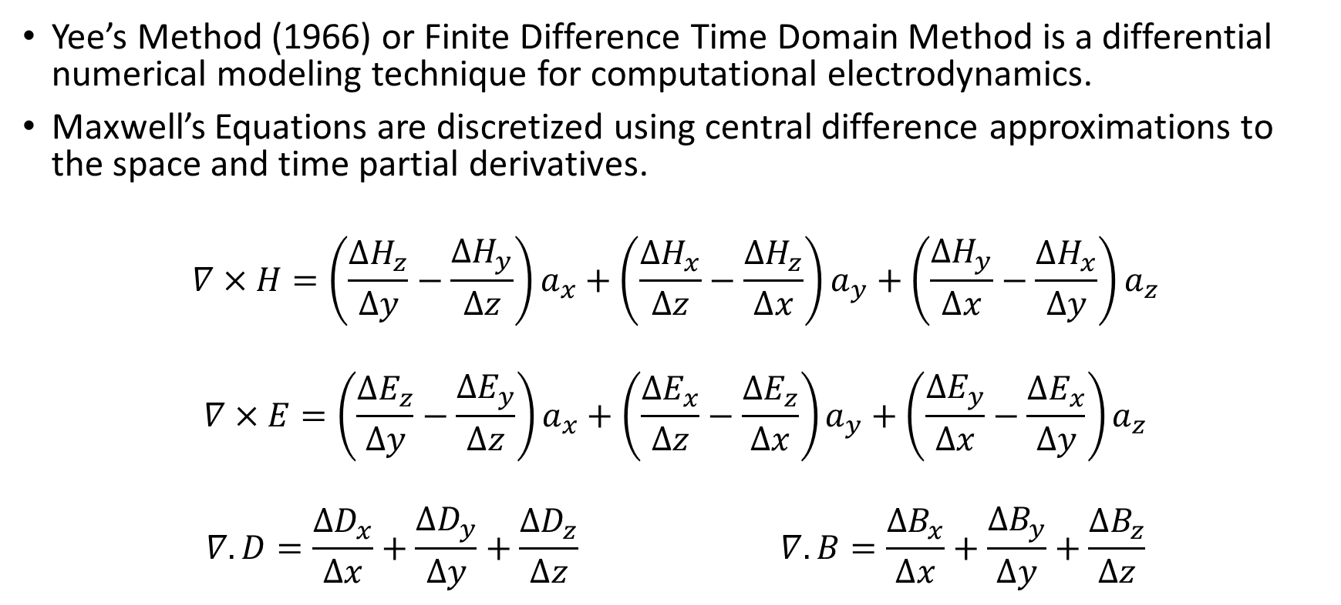
MEEP: Finite Difference Time Domain Method
Yee’s Method (1966) or Finite Difference Time Domain Method is a differential numerical modeling technique for computational electrodynamics.
Maxwell’s Equations are discretized using central difference approximations to the space and time partial derivatives.
$$∇×H=\left(\frac{∆H_{z}}{∆y}−\frac{∆H_{y}}{∆z}\right)a_{x}+\left(\frac{∆H_{x}}{∆z}−\frac{∆H_{z}}{∆x}\right)a_{y}+\left(\frac{∆H_{y}}{∆x}−\frac{∆H_{x}}{∆y}\right)a_{z}$$
$$∇×E=\left(\frac{∆E_{z}}{∆y}−\frac{∆E_{y}}{∆z}\right)a_{x}+\left(\frac{∆E_{x}}{∆z}−\frac{∆E_{z}}{∆x}\right)a_{y}+\left(\frac{∆E_{y}}{∆x}−\frac{∆E_{x}}{∆y}\right)a_{z}$$
$$∇.D=\frac{∆D_{x}}{∆x}+\frac{∆D_{y}}{∆y}+\frac{∆D_{z}}{∆z} ∇.B=\frac{∆B_{x}}{∆x}+\frac{∆B_{y}}{∆y}+\frac{∆B_{z}}{∆z}$$

Slide 19
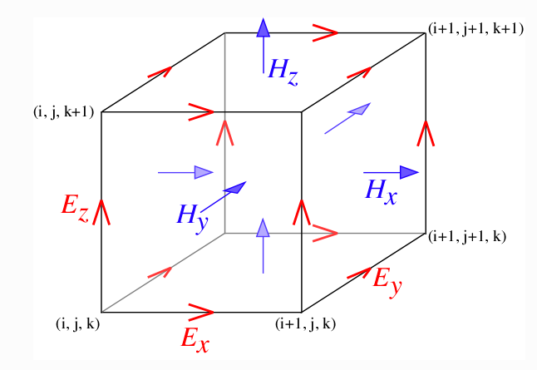
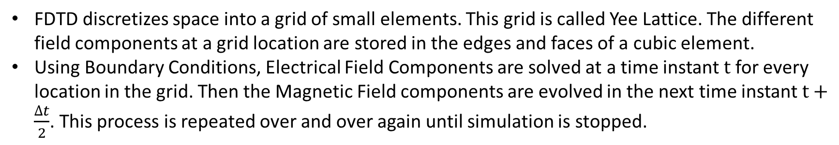
MEEP: Yee Lattice
FDTD discretizes space into a grid of small elements. This grid is called Yee Lattice. The different field components at a grid location are stored in the edges and faces of a cubic element.
Using Boundary Conditions, Electrical Field Components are solved at a time instant $t$ for every location in the grid. Then the Magnetic Field components are evolved in the next time instant $t+\frac{∆t}{2}$. This process is repeated over and over again until simulation is stopped.

Slide 20
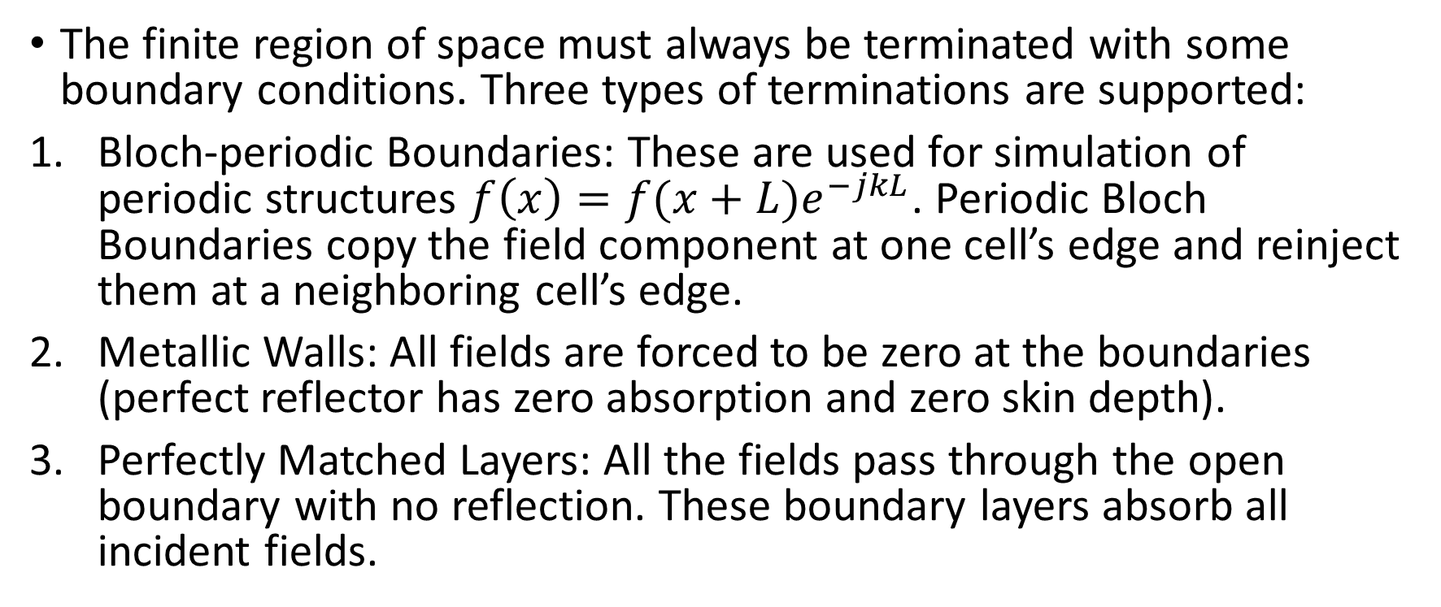
MEEP: Boundary Conditions
The finite region of space must always be terminated with some boundary conditions. Three types of terminations are supported:
Bloch-periodic Boundaries: These are used for simulation of periodic structures $f\left(x\right)=f(x+L)e^{−jkL}$. Periodic Bloch Boundaries copy the field component at one cell’s edge and reinject them at a neighboring cell’s edge.
Metallic Walls: All fields are forced to be zero at the boundaries (perfect reflector has zero absorption and zero skin depth).
Perfectly Matched Layers: All the fields pass through the open boundary with no reflection. These boundary layers absorb all incident fields.

Slide 21
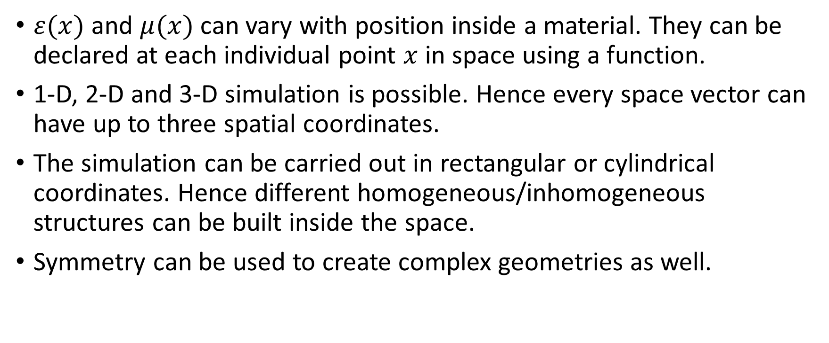
MEEP: Material Inhomogeneity
$ε(x)$ and $μ(x)$ can vary with position inside a material. They can be declared at each individual point $x$ in space using a function.
1-D, 2-D and 3-D simulation is possible. Hence every space vector can have up to three spatial coordinates.
The simulation can be carried out in rectangular or cylindrical coordinates. Hence different homogeneous/inhomogeneous structures can be built inside the space.
Symmetry can be used to create complex geometries as well.

Slide 22
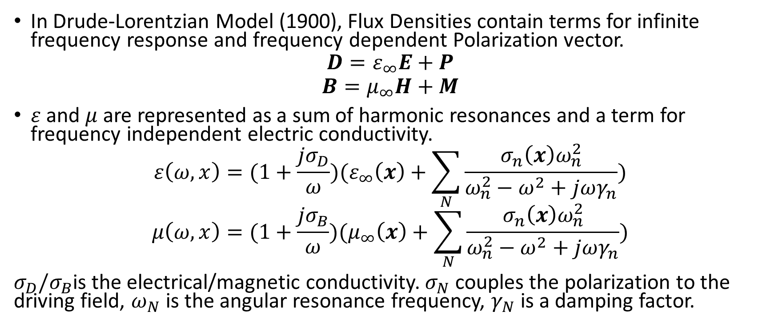
MEEP: Material Dispersion
In Drude-Lorentzian Model (1900), Flux Densities contain terms for infinite frequency response and frequency dependent Polarization vector.
$$D=ε_{∞}E+P$$
$$B=μ_{∞}H+M$$
$ε$ and $μ$are represented as a sum of harmonic resonances and a term for frequency independent electric conductivity.
$$ε\left(ω,x\right)=(1+\frac{jσ_{D}}{ω})(ε_{∞}\left(x\right)+\sum_{N}{\frac{σ_{n}\left(x\right)ω_{n}^{2}}{ω_{n}^{2}−ω^{2}+jωγ_{n}}})$$
$$μ\left(ω,x\right)=(1+\frac{jσ_{B}}{ω})(μ_{∞}\left(x\right)+\sum_{N}{\frac{σ_{n}\left(x\right)ω_{n}^{2}}{ω_{n}^{2}−ω^{2}+jωγ_{n}}})$$
$σ_{D}/σ_{B}$is the electrical/magnetic conductivity. $σ_{N}$ couples the polarization to the driving field, $ω_{N}$ is the angular resonance frequency, $γ_{N}$ is a damping factor.

Slide 23
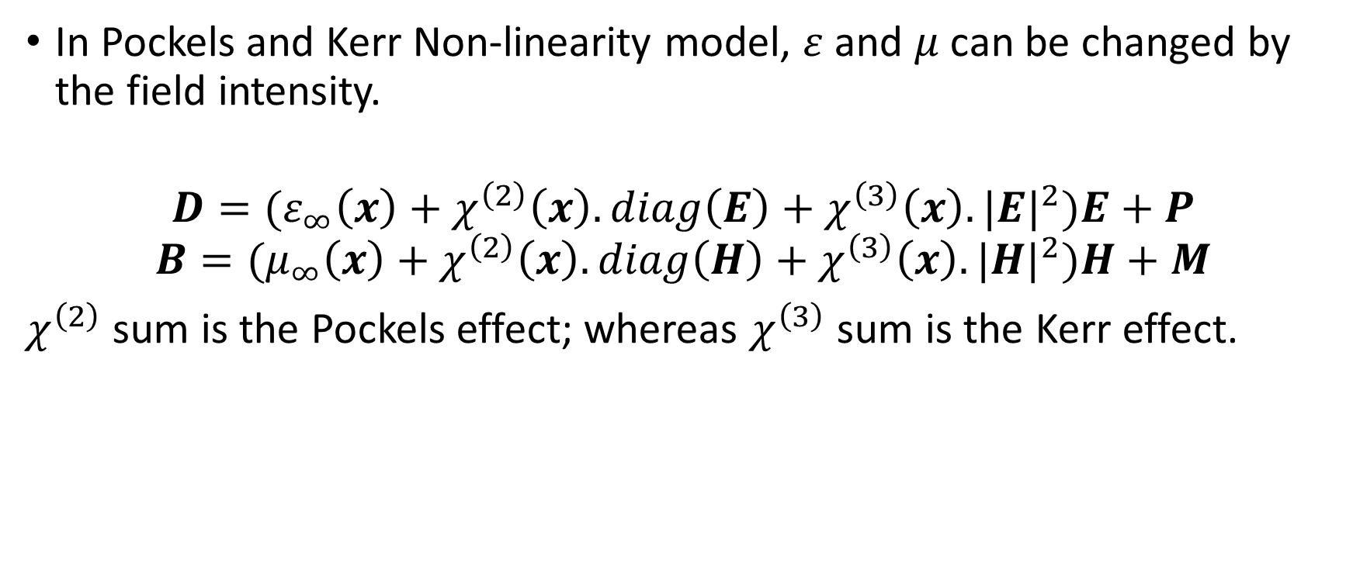
MEEP: Material Non-Linearity
In Pockels and Kerr Non-linearity model, $ε$ and $μ$can be changed by the field intensity.
$$D=(ε_{∞}\left(x\right)+χ^{\left(2\right)}\left(x\right).diag\left(E\right)+χ^{\left(3\right)}\left(x\right).{|E|}^{2})E+P$$
$$B=(μ_{∞}\left(x\right)+χ^{\left(2\right)}\left(x\right).diag\left(H\right)+χ^{\left(3\right)}\left(x\right).{|H|}^{2})H+M$$
$χ^{\left(2\right)}$ sum is the Pockels effect; whereas $χ^{\left(3\right)}$ sum is the Kerr effect.

Slide 24
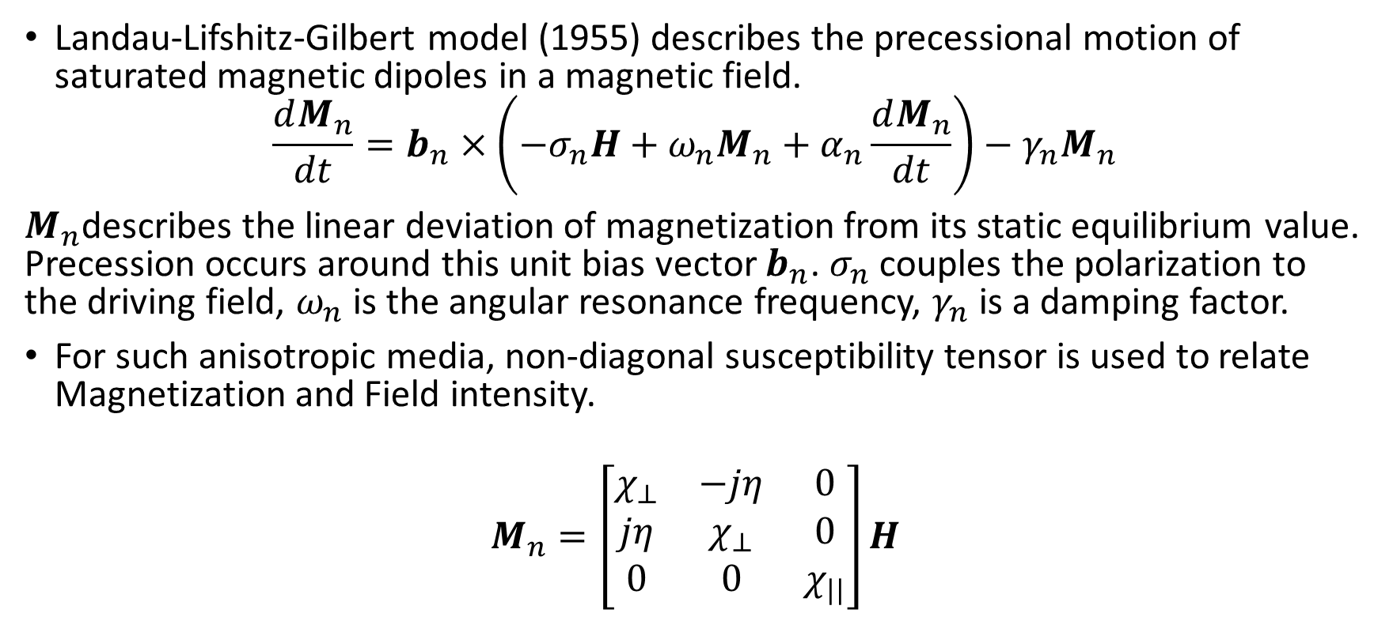
MEEP: Gyromagnetism
Landau-Lifshitz-Gilbert model (1955) describes the precessional motion of saturated magnetic dipoles in a magnetic field.
$$\frac{dM_{n}}{dt}=b_{n}×\left(−σ_{n}H+ω_{n}M_{n}+α_{n}\frac{dM_{n}}{dt}\right)−γ_{n}M_{n}$$
$M_{n}$describes the linear deviation of magnetization from its static equilibrium value. Precession occurs around this unit bias vector $b_{n}$. $σ_{n}$ couples the polarization to the driving field, $ω_{n}$ is the angular resonance frequency, $γ_{n}$ is a damping factor.
For such anisotropic media, non-diagonal susceptibility tensor is used to relate Magnetization and Field intensity.
$$M_{n}=\left[\begin{matrix}χ_{⊥} & −jη & 0 \\ jη & χ_{⊥} & 0 \\ 0 & 0 & χ_{||}\end{matrix}\right]H$$

Slide 25
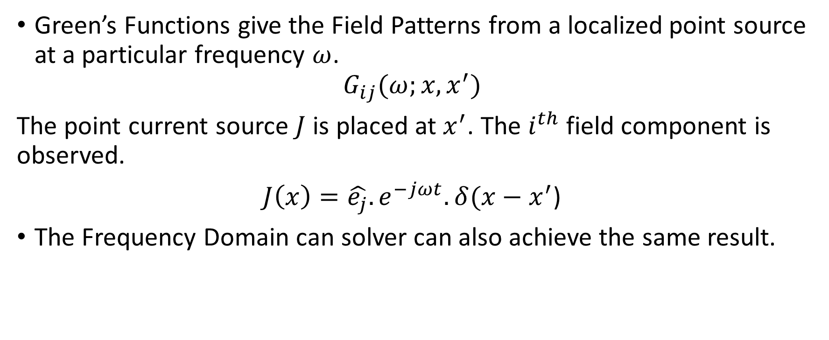
MEEP: Field Patterns and Green’s Functions
Green’s Functions give the Field Patterns from a localized point source at a particular frequency $ω$.
$$G_{ij}(ω;x,x^{′})$$
The point current source $J$ is placed at $x^{′}$. The $i^{th}$ field component is observed.
$J\left(x\right)=\hat{e_{j}}.e^{−jωt}.δ(x−x^{′}$)
The Frequency Domain can solver can also achieve the same result.

Slide 26
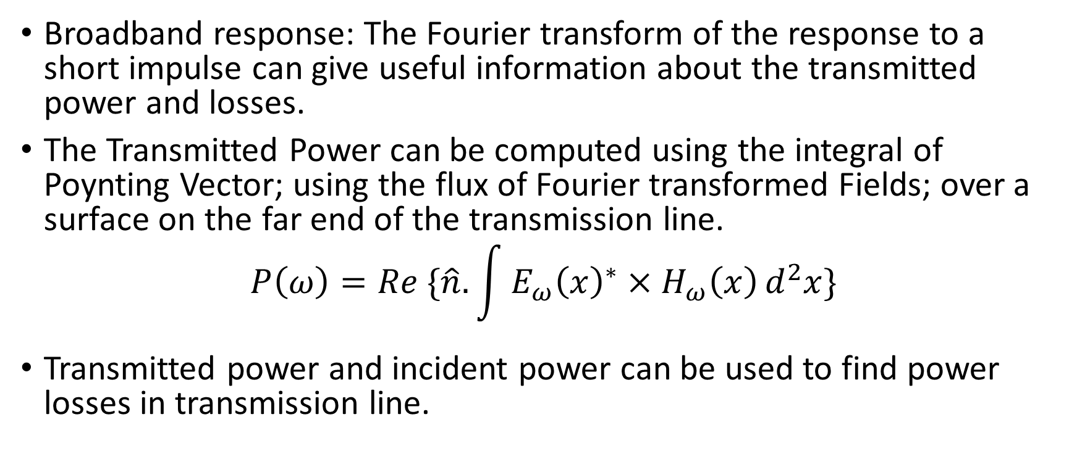
MEEP: Transmittance Spectra
Broadband response: The Fourier transform of the response to a short impulse can give useful information about the transmitted power and losses.
The Transmitted Power can be computed using the integral of Poynting Vector; using the flux of Fourier transformed Fields; over a surface on the far end of the transmission line.
$$P\left(ω\right)=Re \{\hat{n}.\int{{E_{ω}\left(x\right)}^{∗}×H_{ω}\left(x\right)}d^{2}x\}$$
Transmitted power and incident power can be used to find power losses in transmission line.

